Slide 1

Space-astra
Made by Nikolay Zhelyazkov

Slide 2
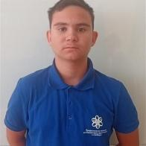
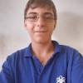
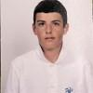
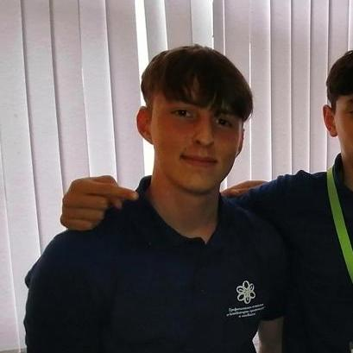
Team Members
Scrum-Trainer
Developer
Developer
Developer

Slide 3
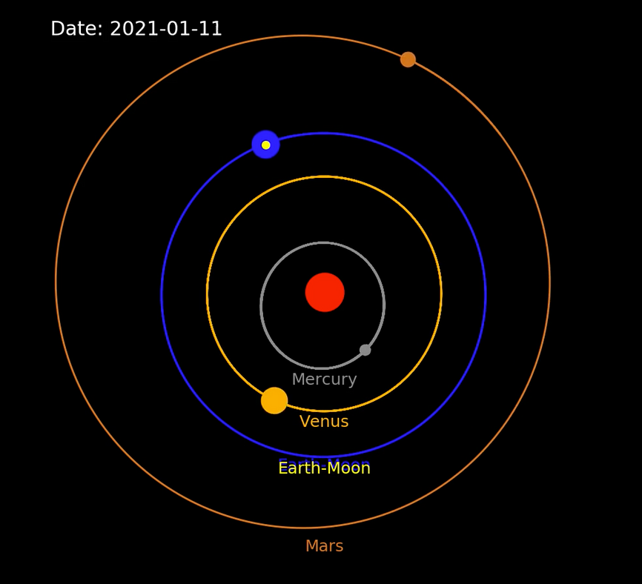
WHAT IS OUR PROJECT’S PURPOSE?
Our project's purpose is to visualise 2-D Objects with gravitational force , which can provide a platform to model and visualize the gravitational interactions between various objects in a simulated space. The User has the freedom to choose whether they like to do inside it.

Slide 4
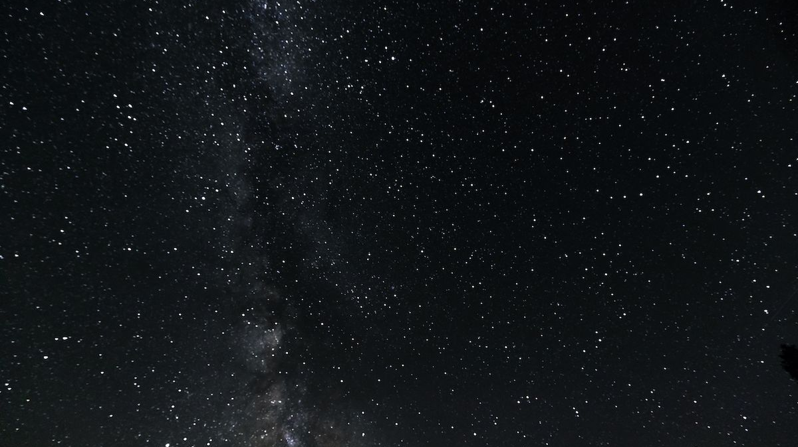
Why did we develop it, what was our motivation?
The development of our Project is to educate and revise people from the program we have made by using formulas and understanding the 2- dimensional world from here . It is also our task to ensure how it looks like a simulation and may ensure teenagers to understand the app easily and so physics. It should be said that in the next few generations, the world will change it is habit of life and might be great to know some experience with programming.

Slide 5






Contributing Services

Slide 6
Thank you for your attention!

